Slide 1



Members:
Floro Ocero, Jr.
Tristan Amiel Clemen
Daniel Serognas
Joshua Formentera
Kennith James Pecato
Agnes Pamisa
AquaSync
Water Monitoring Application

Slide 2

INTRODUCTION
AquaSync: Your Water, Your Control
AquaSync is a simple and intuitive app that helps users monitor their monthly water usage. By providing clear insights and practical tips, AquaSync empowers you to make informed decisions and adopt sustainable habits to conserve water. Take control of your water consumption and contribute to responsible resource management with AquaSync.
Notes:
Aqua": The Latin word for water emphasizes the app's core focus on monitoring water usage, aligning with its purpose to promote water conservation and awareness.
"Sync": This suggests synchronization, which reflects how the app helps users keep their water usage data organized, updated, and in harmony with their conservation goals.
Combined Meaning: Together, "AquaSync" implies seamless synchronization with water-saving habits and efficient management of water resources. It conveys a sense of innovation, responsibility, and connection between users and their water consumption.

Slide 3
Objectives
The primary objective of AquaSync is to promote water conservation by providing individuals with an easy-to-use tool for monitoring their water usage. The app aims to raise awareness about monthly consumption patterns, encourage mindful water use, and help users adopt sustainable habits. By making water tracking accessible, AquaSync empowers users to make informed decisions and contribute to the preservation of this vital resource for future generations.

Slide 4
Scope and Delimitation
Scope This study focuses on the development of AquaSync, a desktop application designed to help users monitor their monthly water consumption. The app includes features for recording water usage, calculating the monthly total, and providing practical tips to reduce water waste. AquaSync aims to assist users in becoming more aware of their water usage patterns and making more sustainable choices. The app is intended for individual use, targeting household users who want to track and manage their water consumption effectively.
Limitations
The app does not calculate daily water usage; it focuses solely on monthly consumption tracking.
It does not integrate with external devices or sensors to automatically track water consumption; users must manually input their data.
The app is designed as a desktop application only and does not include mobile or web versions.
AquaSync's recommendations and tips are general and not tailored to specific user behaviors or household setups.
The app relies on user accuracy for data input, which may affect the reliability of its calculated insights.

Slide 5
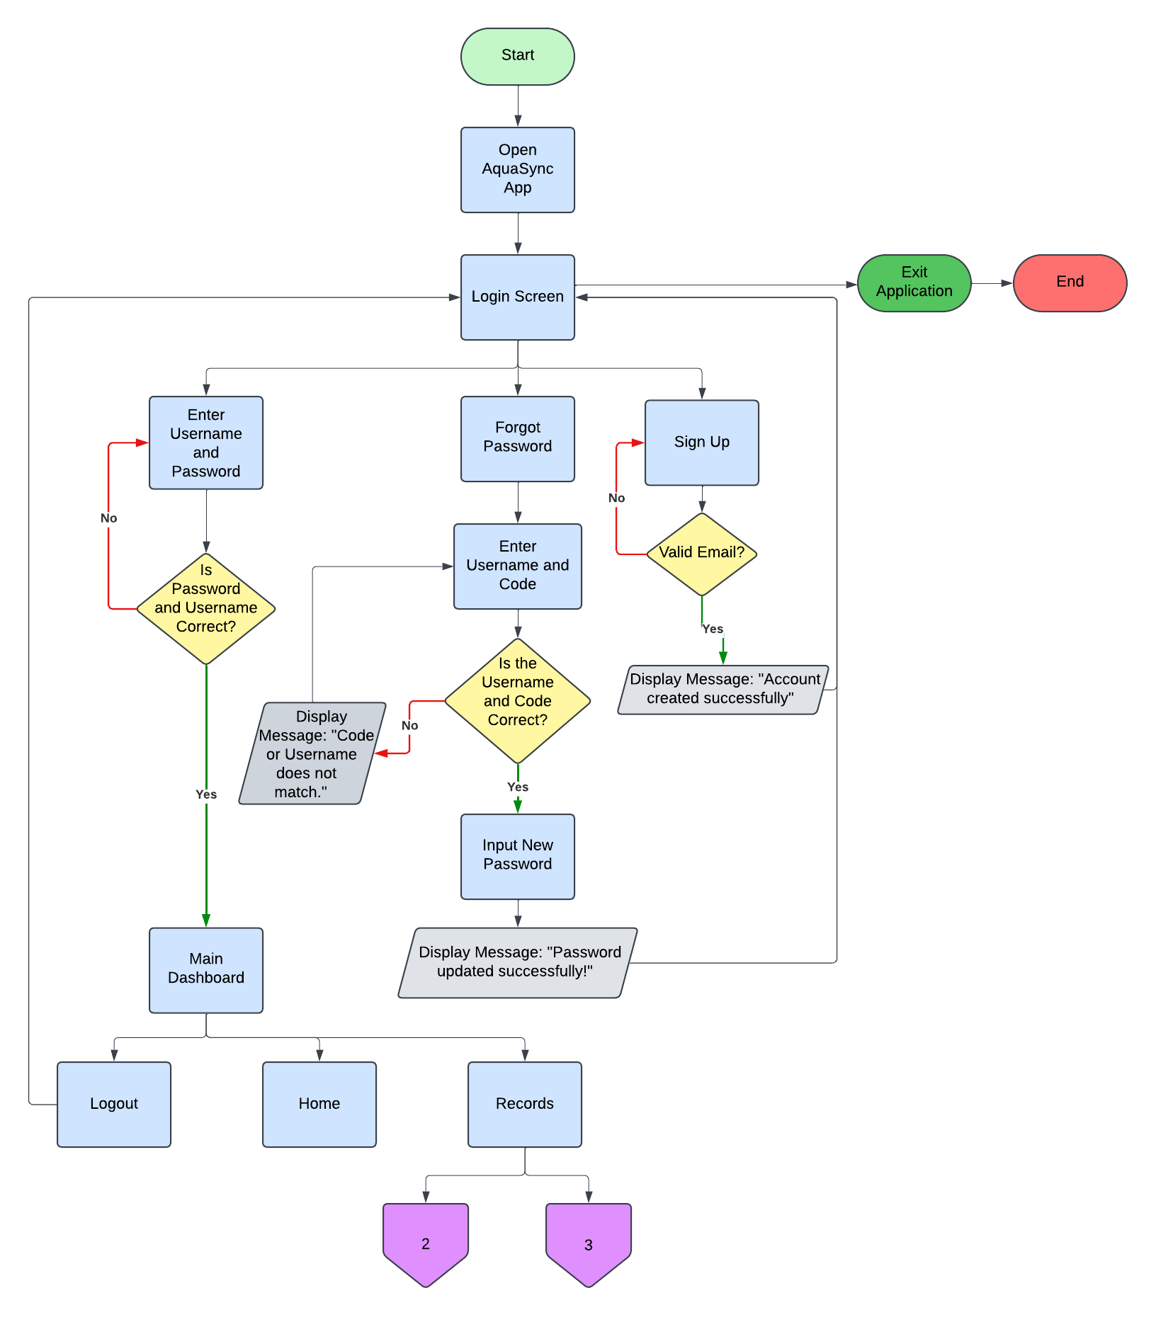
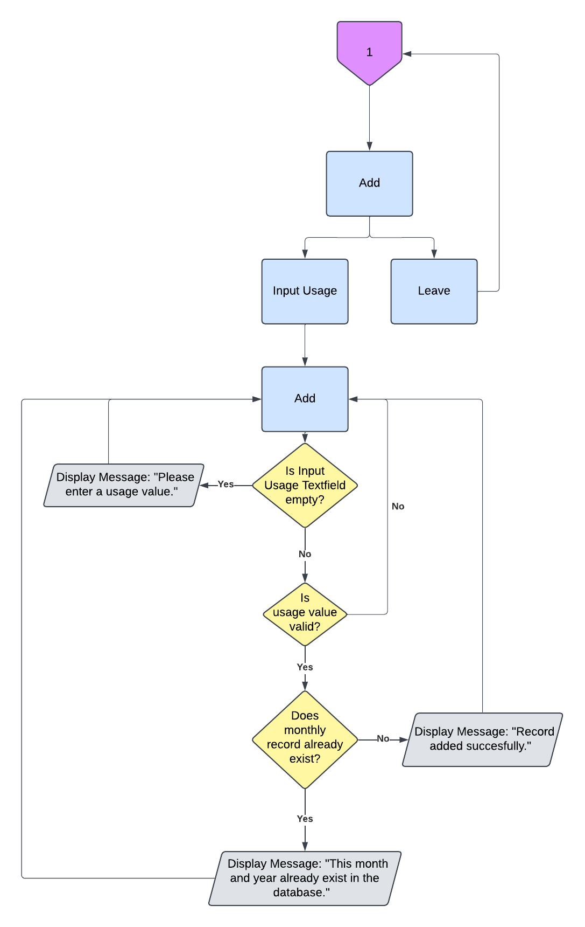
FLOWCHART
Main Flowchart
Adding New Record

Slide 6
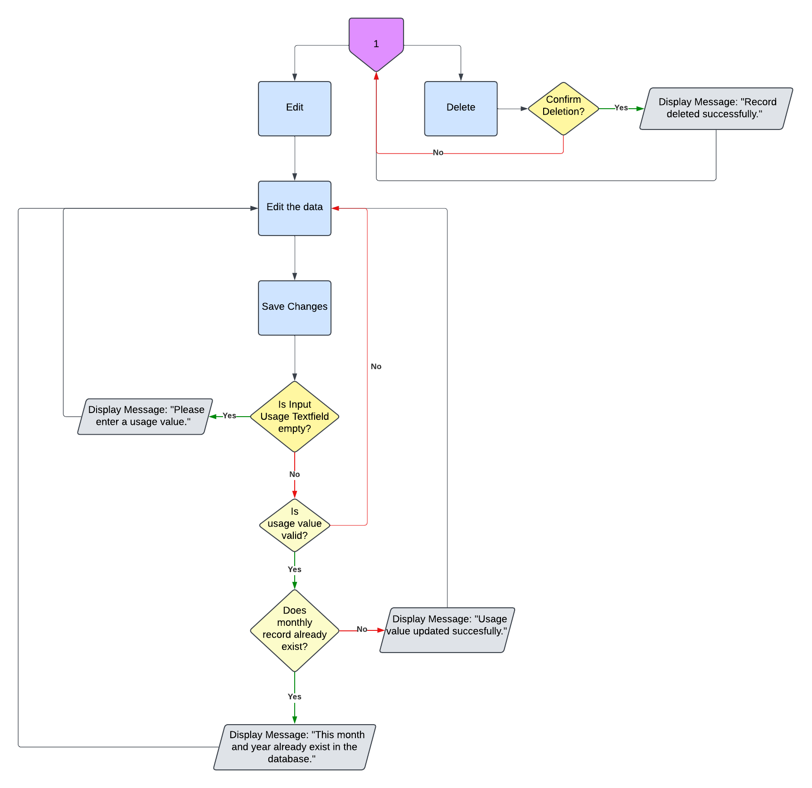
FLOWCHART
Editing and Deleting of Record

Slide 7
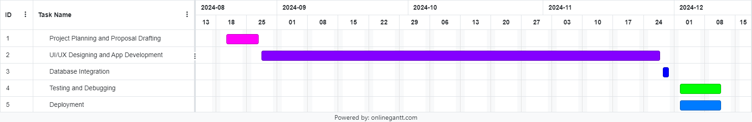
GANTT CHART
The Gantt chart outlines the timeline and key tasks for the development of AquaSync:
Project Planning and Proposal Drafting: Spanning 6 days, this phase starts on August 20, 2024, and concludes on August 27, 2024.
UI/UX Designing and App Development: The longest phase, taking 66 days, from August 28 to November 27, 2024.
Database Integration: Scheduled for 2 days, November 28–29, 2024.
Testing and Debugging: Allocated 8 days, from December 2 to December 11, 2024.
Deployment: Also lasting 8 days, this final stage overlaps with testing, occurring from December 2 to December 11, 2024.

Slide 8
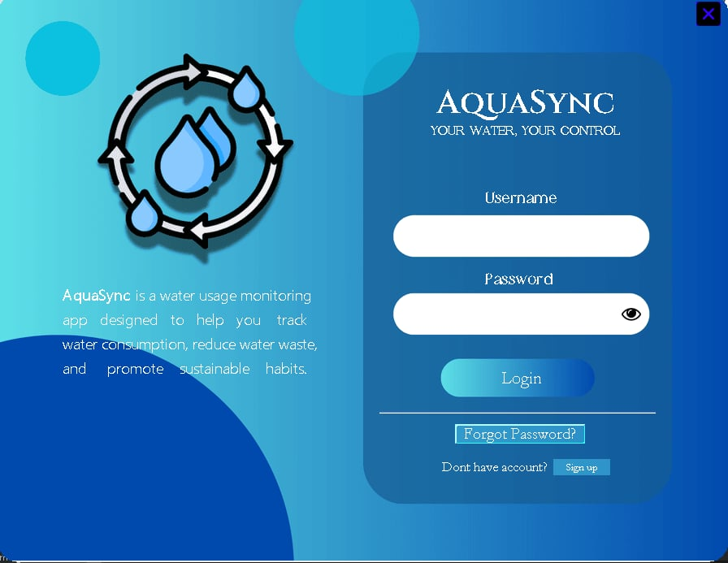
SYSTEM DESIGN
Login Window
Upon launching the application, the user is presented with the login screen. If the user already has an account, they can enter their credentials to log in. In case the user has forgotten their password, they can click the "Forgot Password?" button to reset it. If the user doesn't have an account, they can click the "Sign up" button to create a new one.

Slide 9
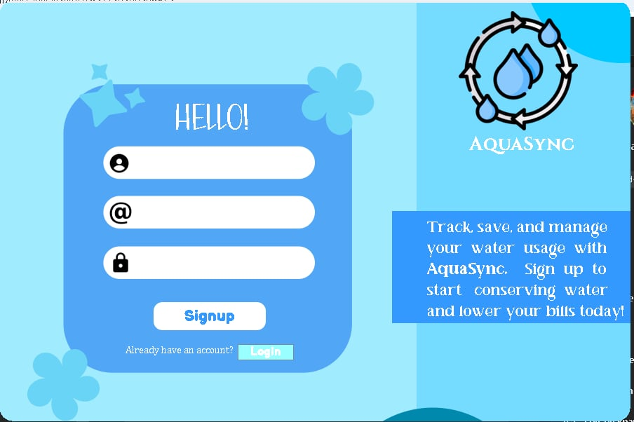
SYSTEM DESIGN
Signup Window
This is the sign-up window, where the user can enter their username, email , and preferred password. By clicking the "Signup" button, a new account will be created. If the user wishes to return to the login screen, they can click the "LogIn" button and enter the credentials they provided during sign-up.

Slide 10
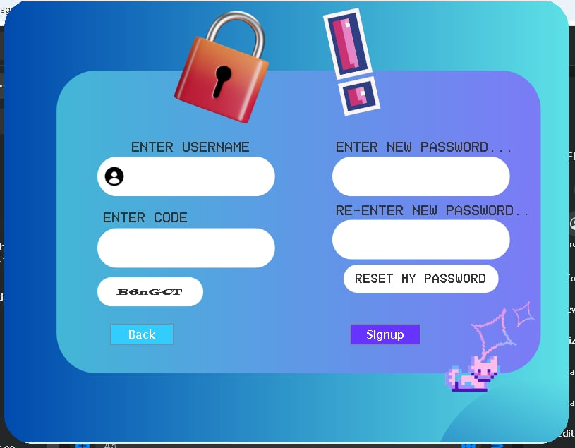
SYSTEM DESIGN
Forgot Password Window
If the user clicks the "Forgot Password" button on the login screen, they will be directed to this window. The user will enter their username and the code displayed on the screen. After that, they can input a new password and click the "RESET MY PASSWORD" button. A pop-up window will appear confirming that the password reset was successful. The user can then return to the login screen and enter their credentials using the newly updated password.

Slide 11
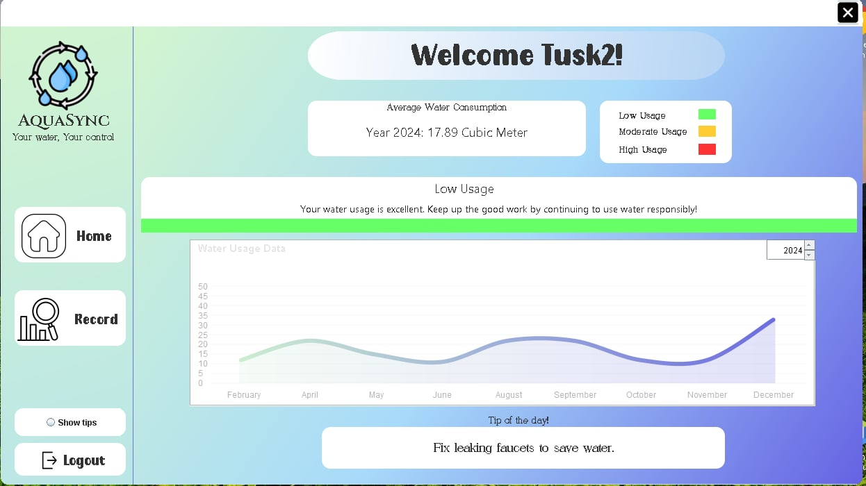
SYSTEM DESIGN
Dashboard
This is the main dashboard displayed upon successful login. It greets the user with a "Welcome, [Username]" message. The dashboard also shows the user's average water consumption, indicating whether their usage is low, moderate, or high. A line graph displaying the water usage entries is included, along with a section at the bottom offering helpful water-saving tips.

Slide 12
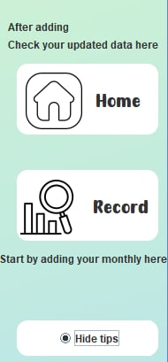
SYSTEM DESIGN
Show Tips
When you click the "Show Tips" radio button on the Dashboard, it will display some instructions on how to use the application.

Slide 13
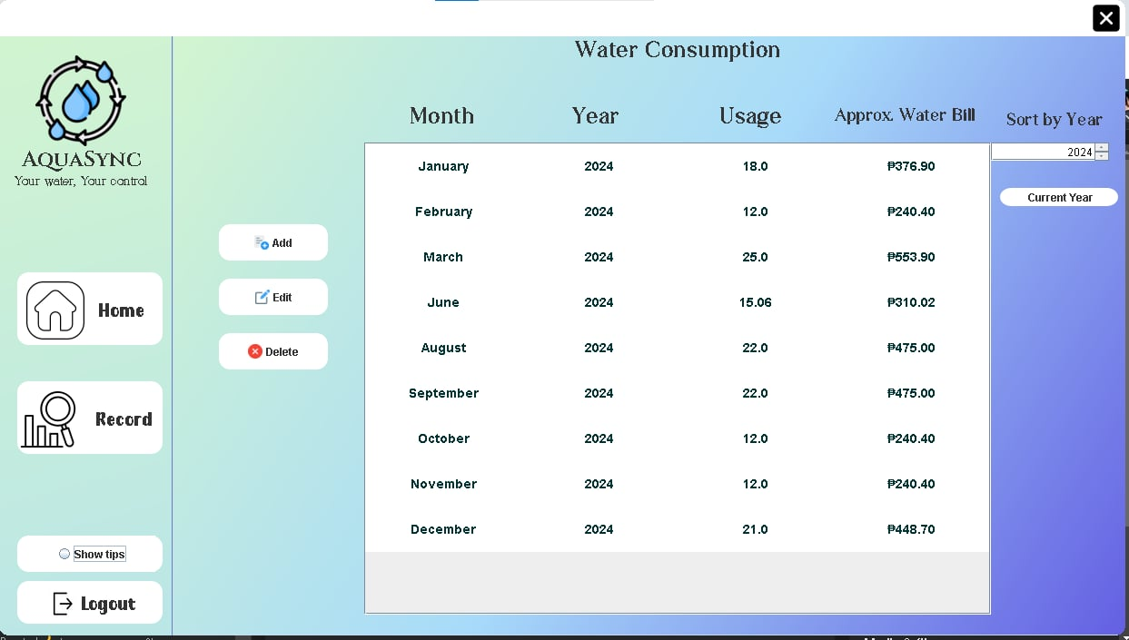
SYSTEM DESIGN
Records Tab
The Records tab allows you to easily add, edit, and delete your water usage records. It includes a table that displays all your entered records in a clear and organized manner. Additionally, the tab shows the approximate water bill for each record, helping you better understand your usage costs.

Slide 14
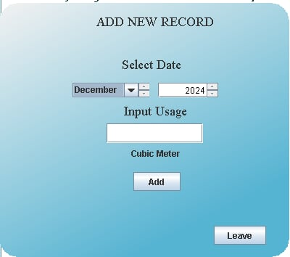
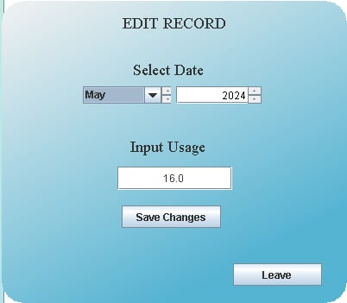
SYSTEM DESIGN
Add Record Popup Window
When you click the "Add" button in the Records tab, a window will appear. In this window, you can select the month and year, then input your water usage in the text field. Clicking the "Add" button will save the data to your database and display it in the table.
Edit Record Popup Window
This is the Edit pop-up window, where you can modify your data. After making the necessary changes, simply click "Save Changes" to update your information. Your data will then be successfully updated.

Slide 15
CONCLUSION
The AquaSync app serves as a practical and user-friendly solution to address the growing need for water conservation. By allowing users to monitor monthly water usage, the app empowers individuals to make informed decisions and adopt sustainable water consumption practices. Its features, such as detailed logs, helpful tips, and easy accessibility, ensure that users can engage with the app effortlessly to take control of their water consumption habits.
This project not only aims to promote responsible water usage but also raises awareness about the importance of conserving this vital resource. AquaSync demonstrates the potential of technology in addressing environmental challenges and inspiring users to take proactive steps toward sustainable living.

Slide 16
RECOMMENDATION
Encourage users to monitor their water usage regularly through app notifications.
Add a feature to calculate and display the estimated amount of money saved based on reduced water consumption to motivate users further.
Introduce personalized water-saving goals to help users track their progress and stay committed.
Regularly update the app with practical and actionable water-saving tips to keep users informed and inspired.
Enhance the user interface to ensure a seamless and intuitive experience for all users.

